Slide 1

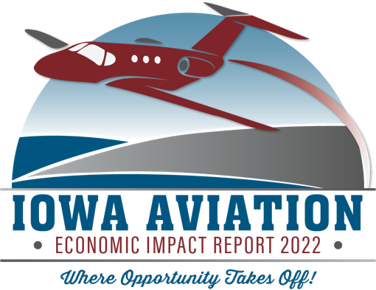

Iowa Aviation
Economic Impact Report
2022
Notes:
Hello and welcome to this presentation for the 2022 Iowa Aviation Economic Impact Report from the Iowa Department of Transportation. The report is based on a study by Jviation, a Woolpert Company, conducted on behalf of the Iowa Department of Transportation’s Modal Transportation Bureau. This presentation will provide an overview of the study’s findings.

Slide 2



THE BIG ANSWER
  $6.4B
  41,000
  $124M
Notes:
Let’s start by giving you The Big Answer first. Aviation in Iowa has a HUGE economic impact: $6.4 billion in annual economic activity, 41,000 total job impacts, and $124m in tax revenue.

Slide 3
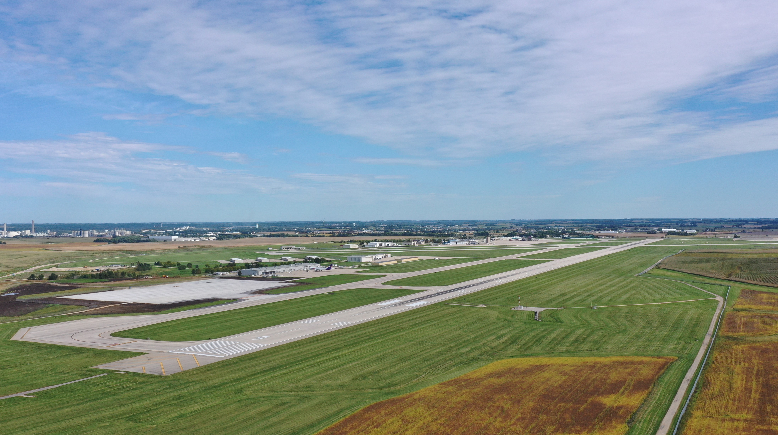
PRESENTATION OUTLINE
USES AND BENEFITS
ECONOMIC IMPACTS
Notes:
Later in the presentation, we will break down some of the components of that Big Answer, but first, let’s cover the scope of aviation activities in Iowa.

Slide 4
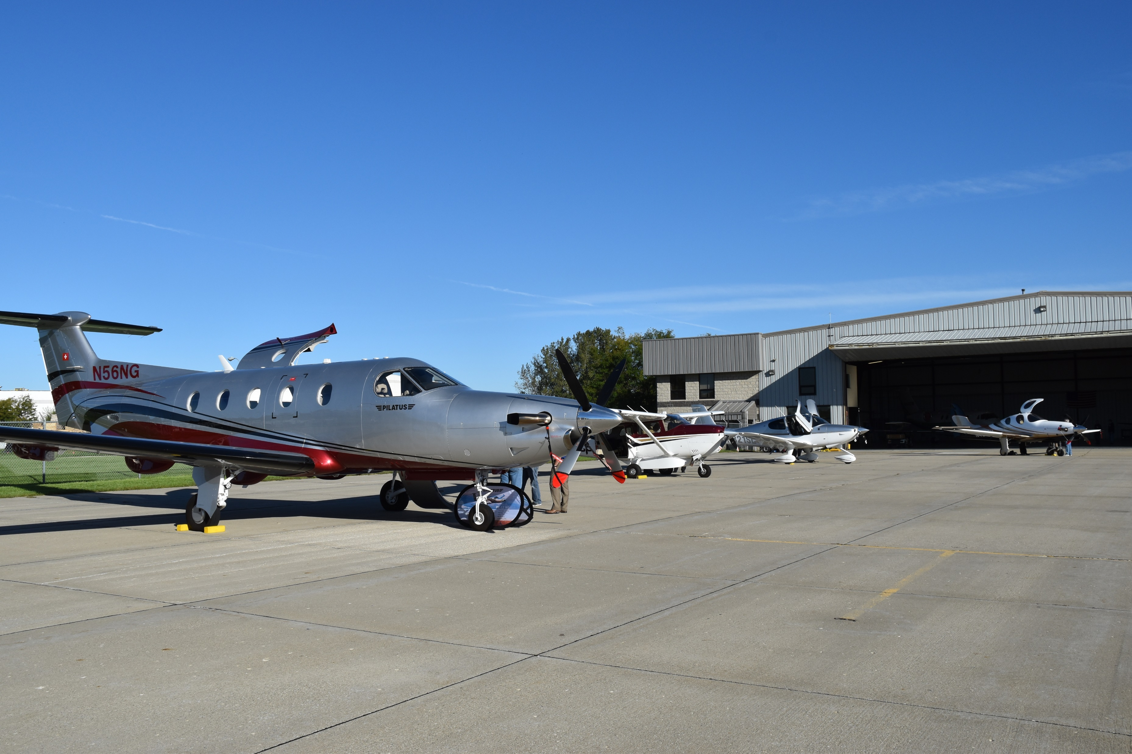

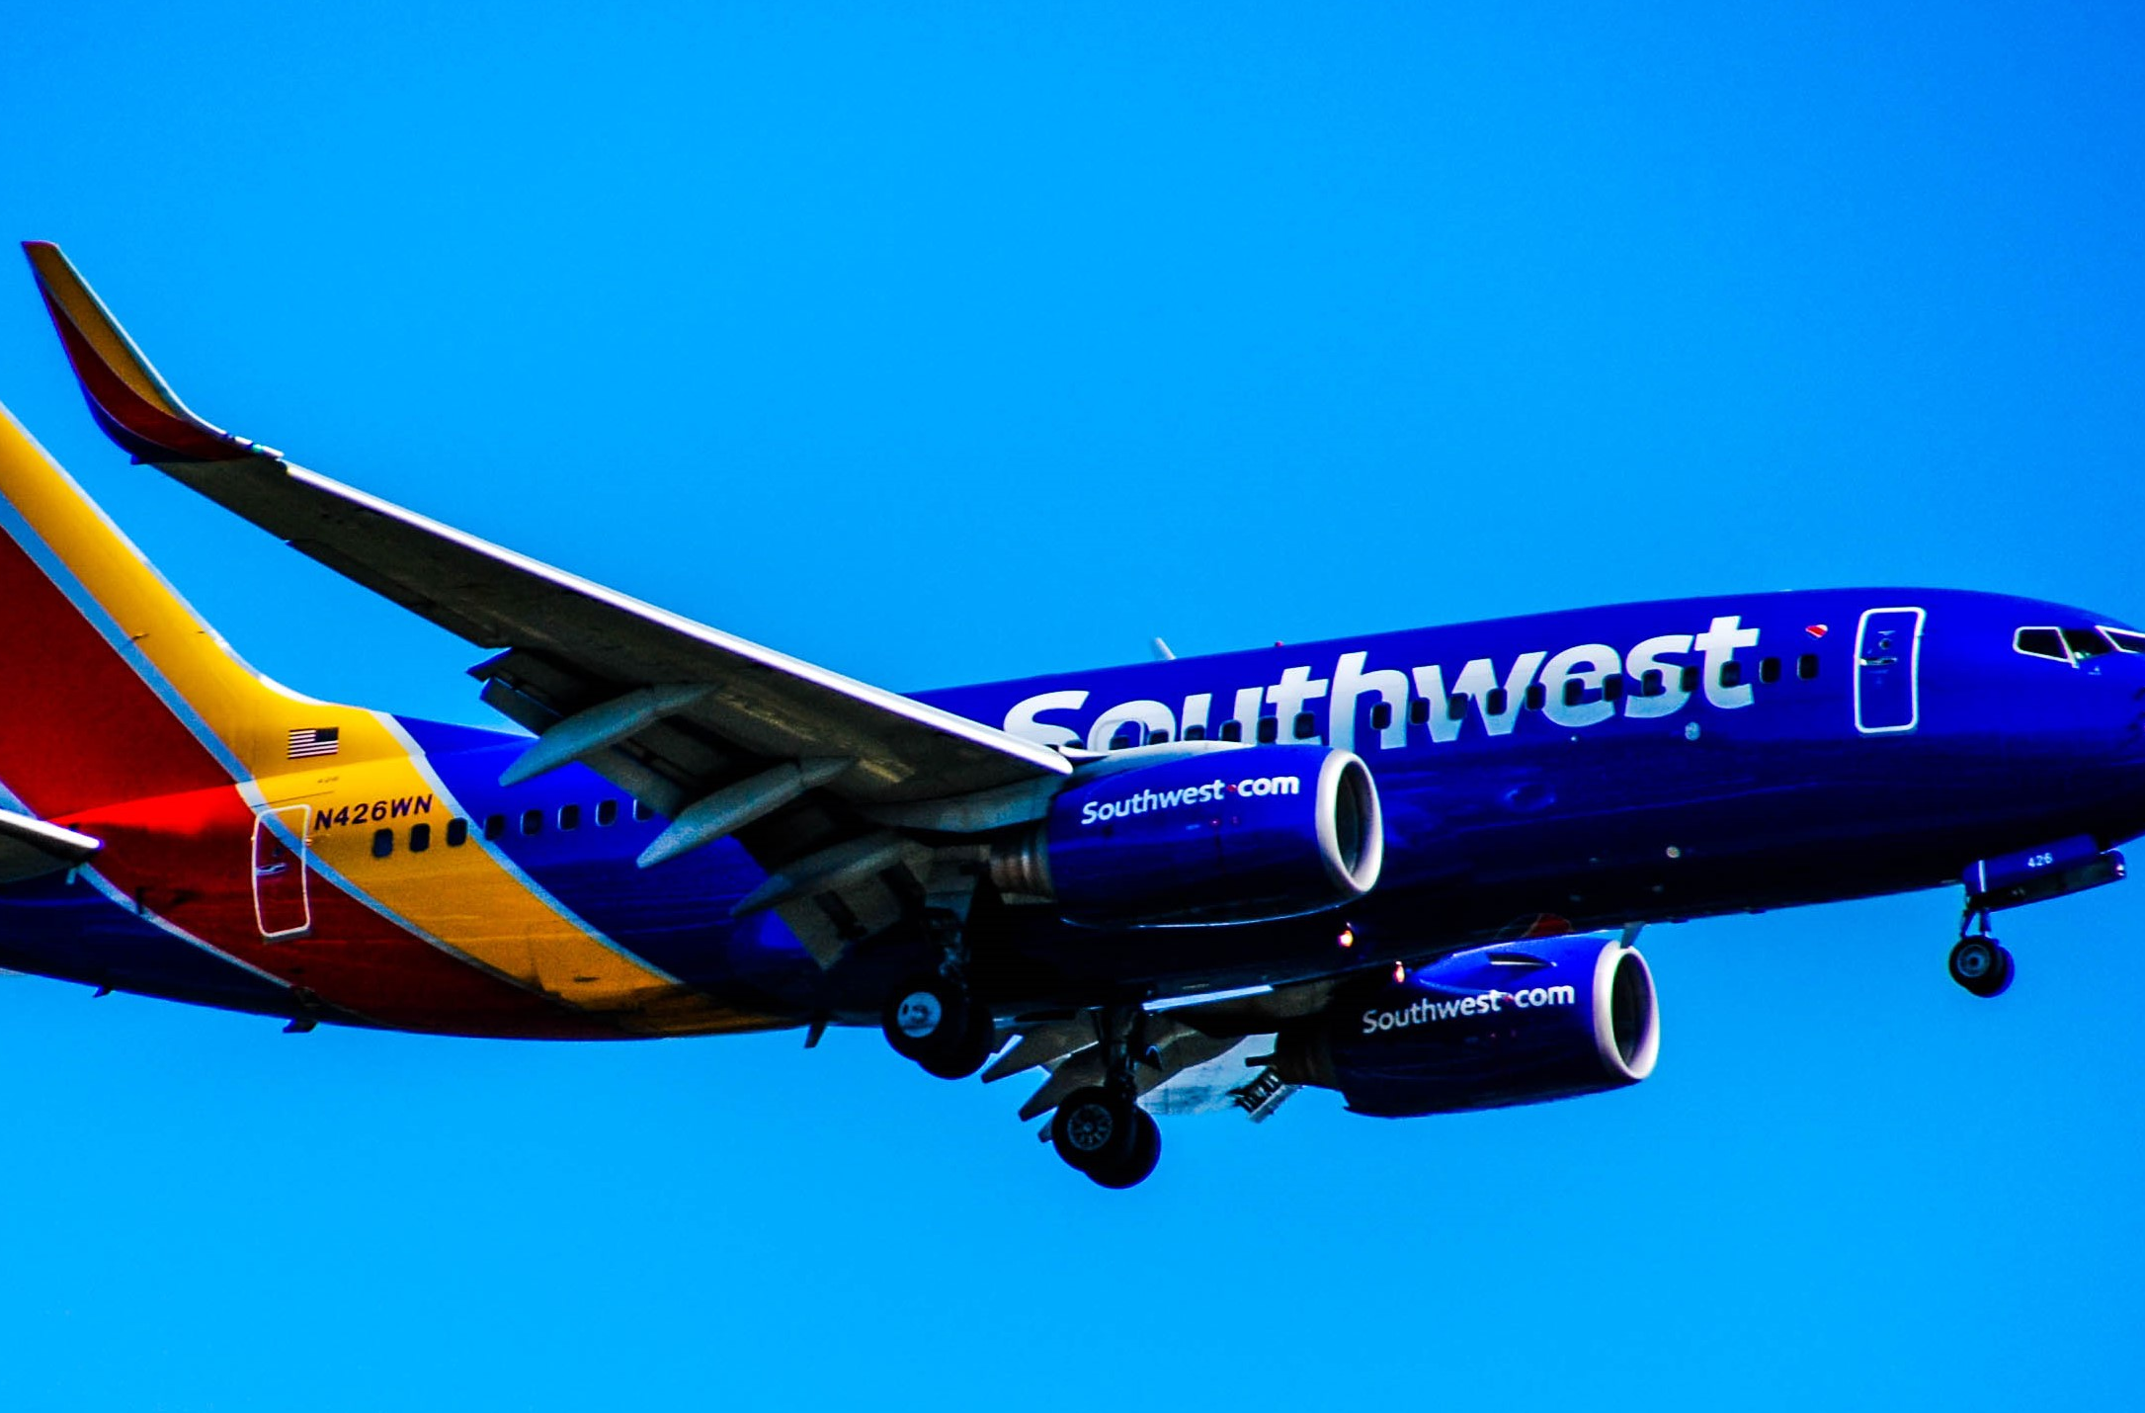
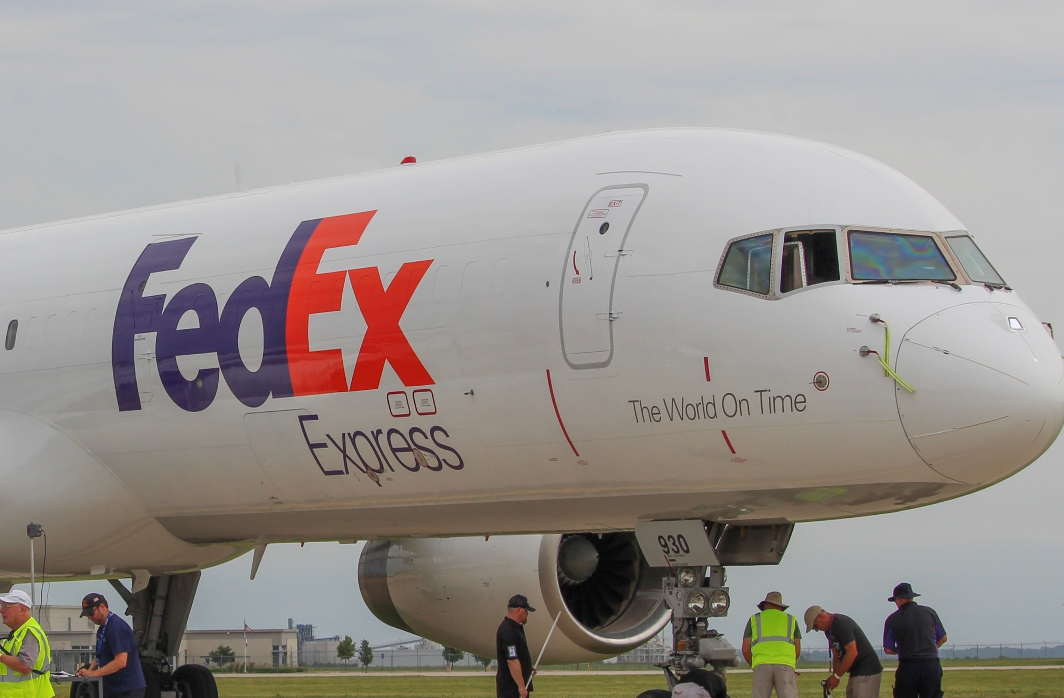
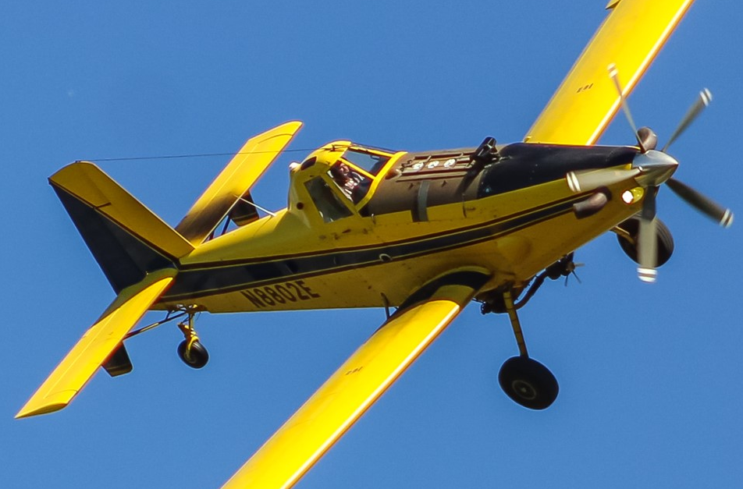
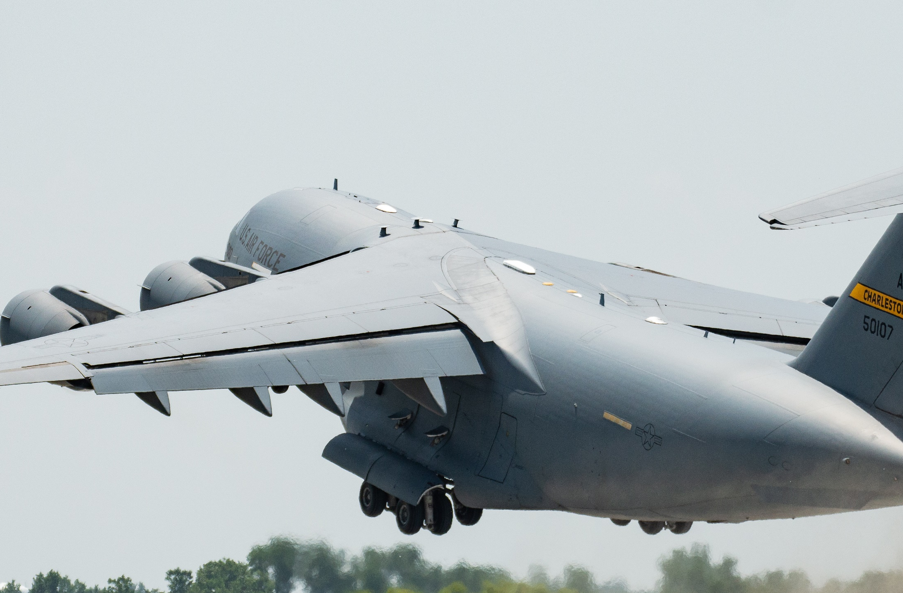
WHAT ARE SOME AVIATION ACTIVITIES THAT GENERATE ECONOMIC IMPACT?
Notes:
Many kinds of aviation activities contribute to economic impacts. Some are obvious and some are not, but all contribute to Iowa’s economy and quality of life; from airlines to air cargo, to military, to aerial application; aviation activity in all forms and from all corners of the state generates economic impact.

Slide 5

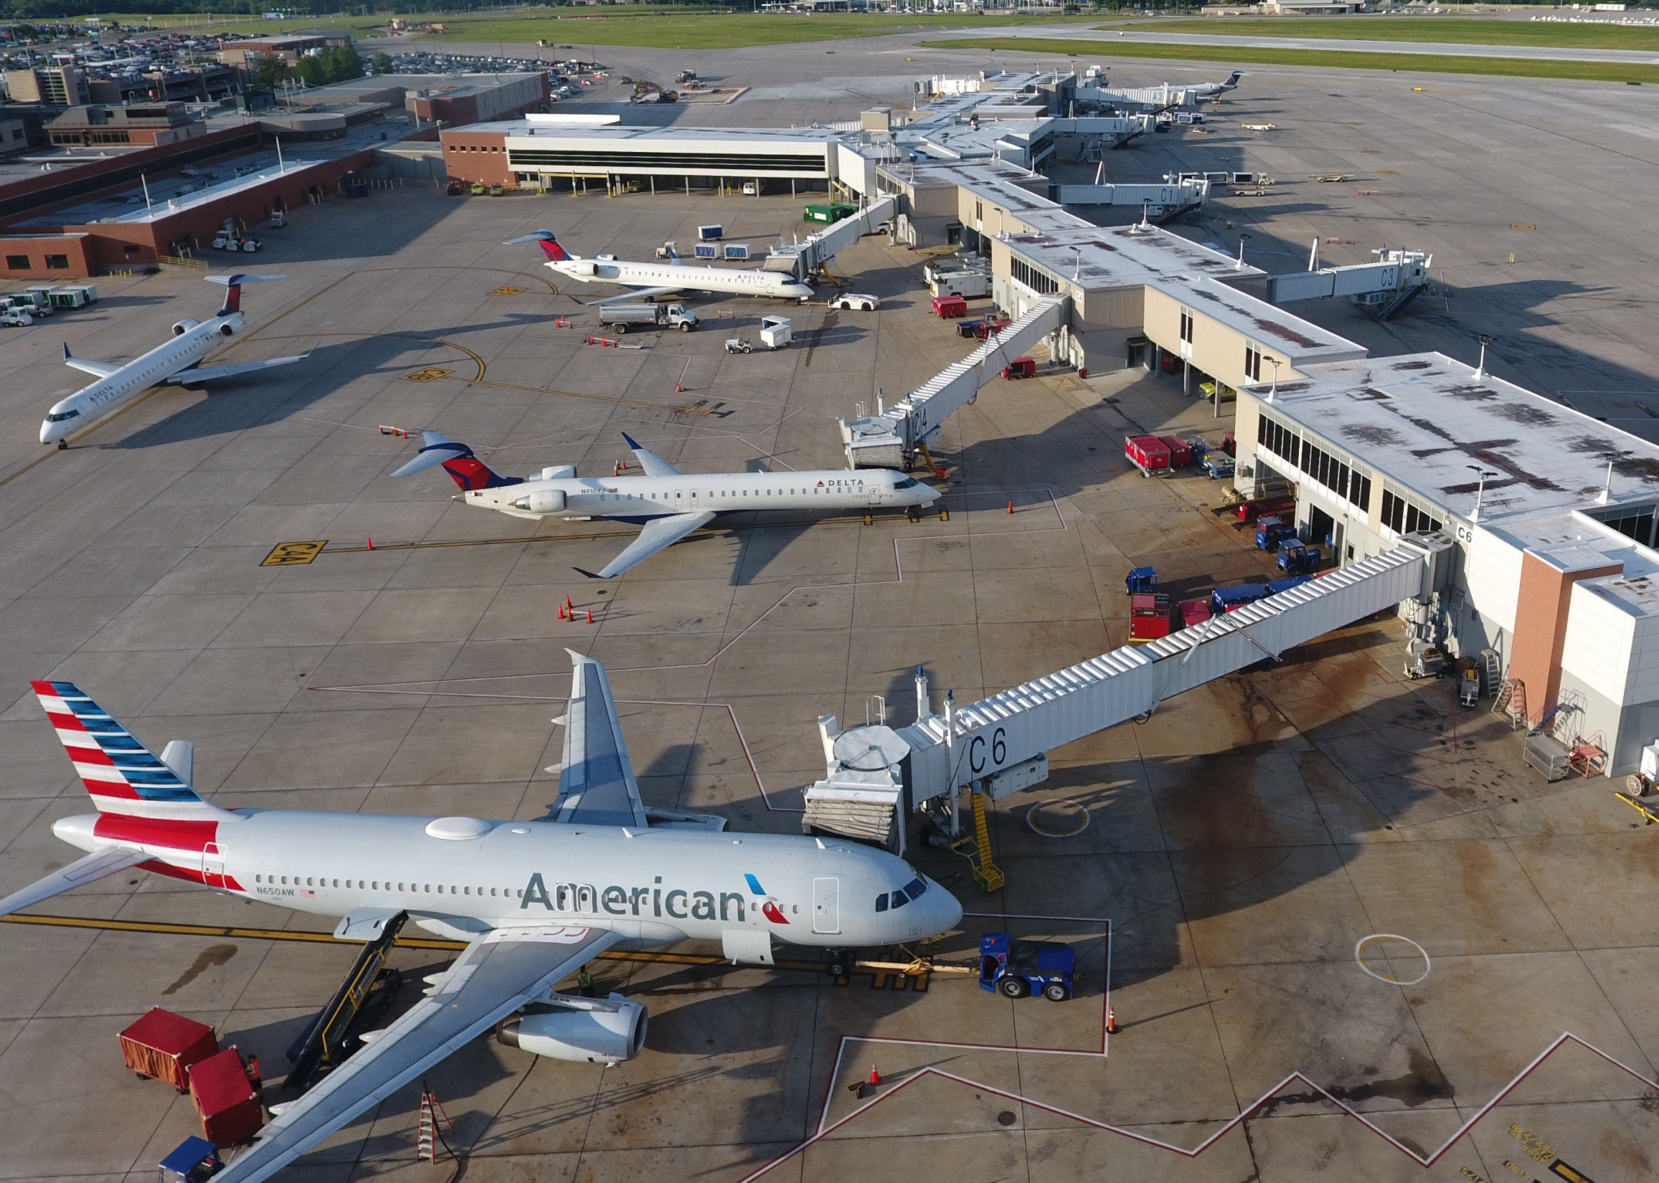
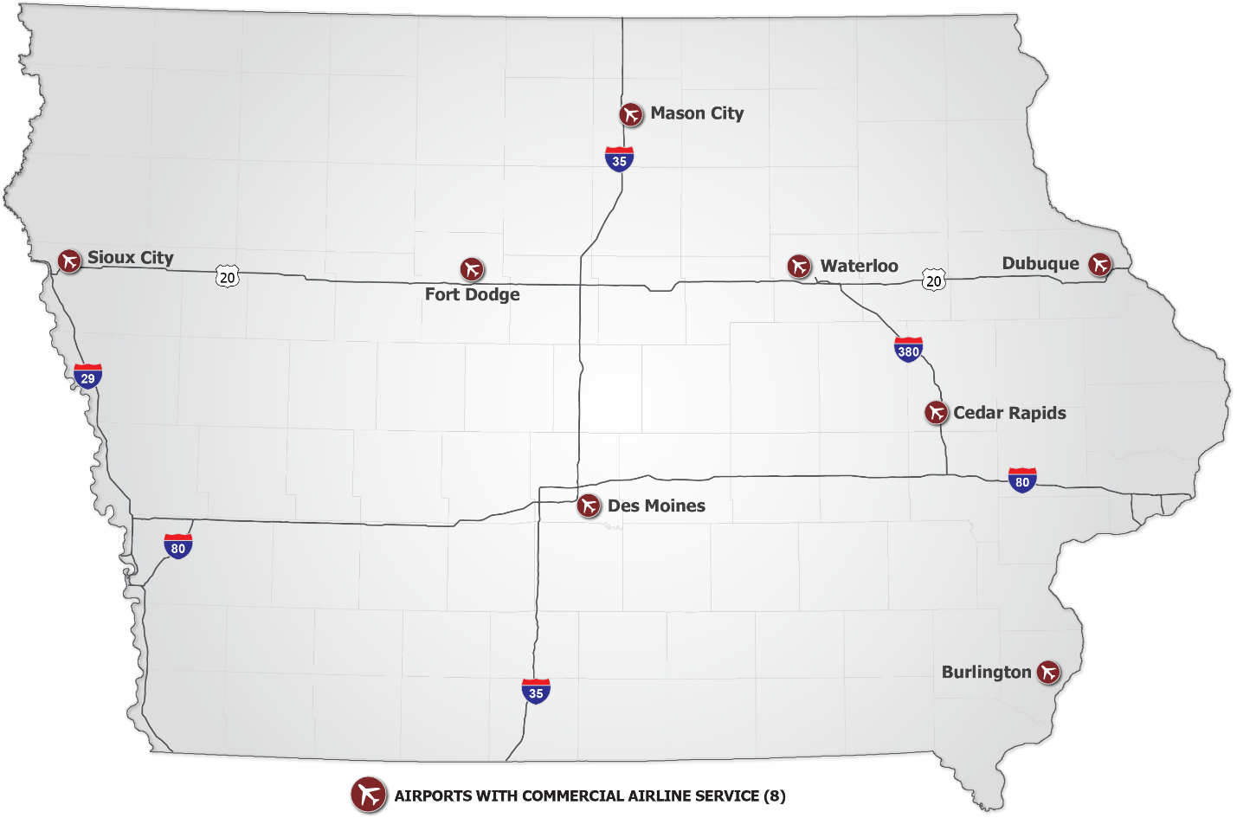

AIRLINE SERVICE
Serving over 4 million passengers with service to 25+ nonstop markets
  8
COMMERCIAL AIRPORTS
Notes:
At the most fundamental level, airline service connects Iowa to the world!
Airlines flying from Iowa’s commercial airports serve four million passengers on an annual basis and provide service to more than 25 nonstop markets, helping companies doing business in Iowa be more efficient, and more successful. But airline impacts also stem from local staff required to operate the aircraft, vendors, rental car companies, airport employees, federal employees that operate security checkpoints and air traffic control towers, and local police and fire departments who ensure public safety.
Airlines also rely on and benefit from investment in airport facilities, which generates construction-related impacts. A significant impact associated with airlines is generated by passenger spending both, in the terminal and, in the local economy.

Slide 6

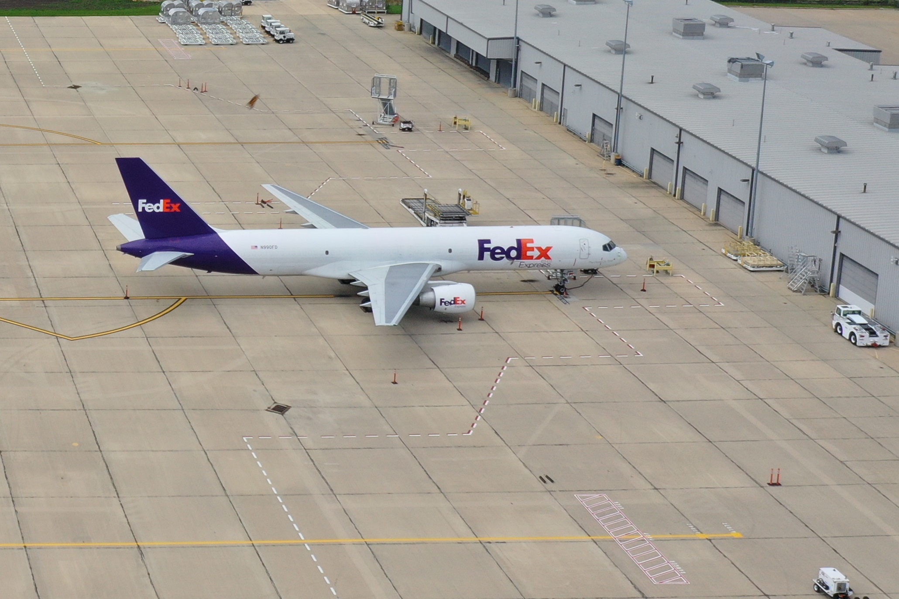
AIR CARGO
Scheduled service provided by large integrators and 20+ on-demand carriers
TOTAL ANNUAL TONS – EnPLANED and DEPLANED
DSM
  90K+
CID
TONS of Cargo moved by air
Notes:
Two Iowa airports, the Des Moines International Airport and The Eastern Iowa Airport in Cedar Rapids, support scheduled air cargo service. Large integrators like UPS and FedEx operate daily flights mainly to their hubs in Louisville and Memphis, among other locations. Over 90,000 tons of cargo is moved by air each year.
While integrated express carriers represent the lion share of air cargo capacity, on demand air cargo haulers use smaller aircraft and fly directly into airports throughout Iowa to serve high priority needs of various industries in Iowa. Airlines also boost revenues with freight and mail carried as “belly” cargo, as space is available.
e-Commerce giant Amazon recently started air cargo flights to Iowa. As e-commerce continues to grow and put pressure on retailers to offer rapid delivery times, reliance on air cargo will likely increase, leading to additional investment in expanded facilities and workforce.

Slide 7

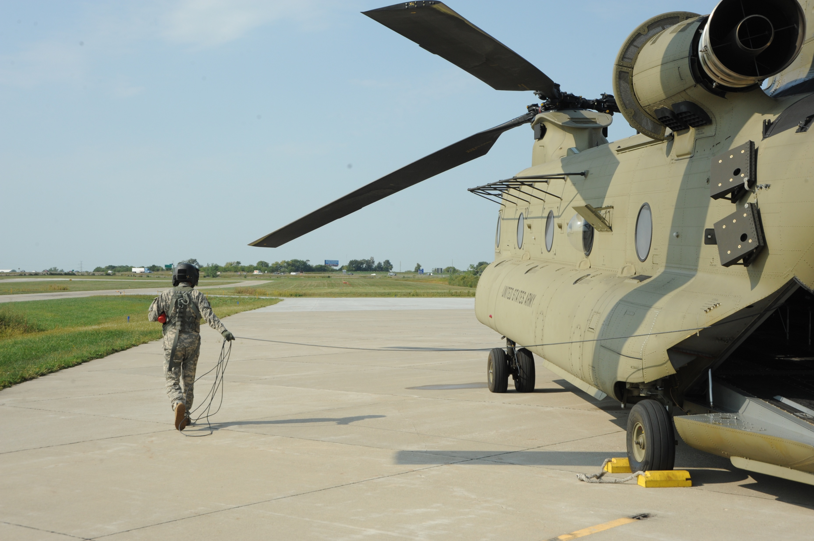
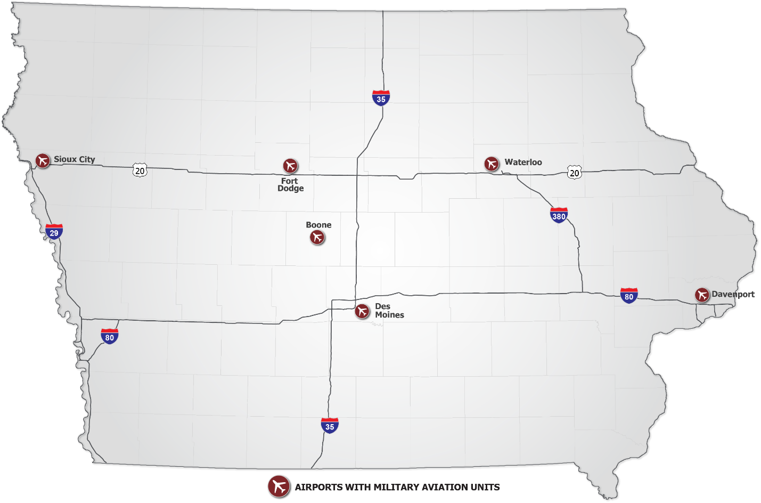
MILITARY
Air National Guard Units and Army Aviation Support Facilities
  6
Airports with military Units
Notes:
Iowa Air National Guard and U.S. Army Aviation units use Iowa airports to support their missions taking place on both a local and global level. Des Moines, Fort Dodge, and Sioux City each support Air National Guard units with unique roles in national defense and security. The three Army Aviation Support Facilities in Boone, Davenport, and Waterloo provide important maintenance and training for helicopter units in Iowa and around the region.

Slide 8
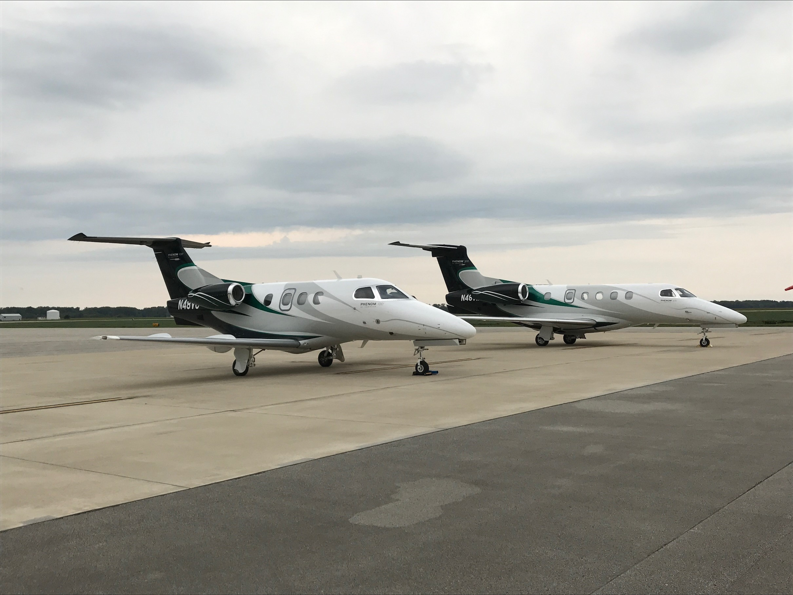

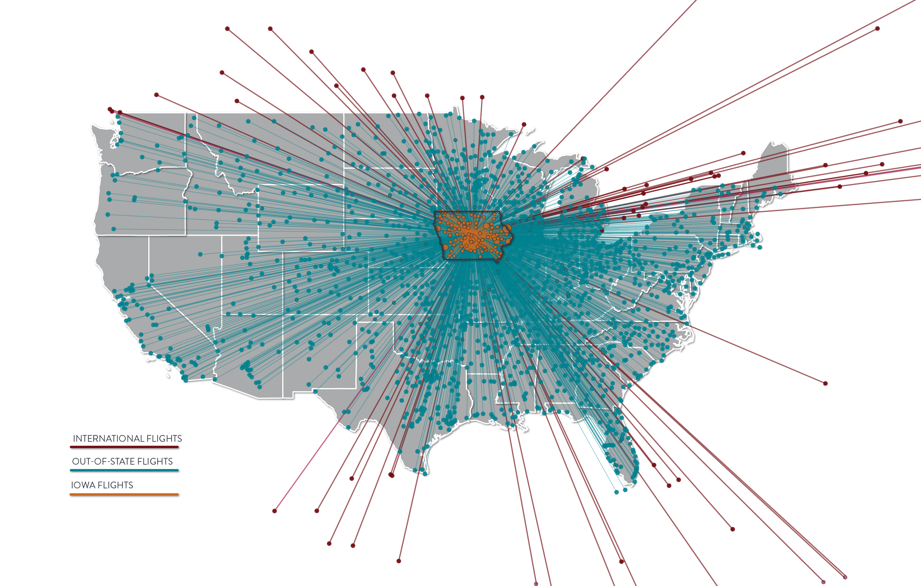
Business Use
From 2019 to 2020, Iowa saw flights to and from 49 states and 27 countries
  1,400+
Unique Businesses using Iowa airports
Notes:
Over the course of study data collection efforts, more than 1,400 unique businesses were identified as using Iowa airports. As the flight map illustrates, Iowa airports support flights to 49 states and 27 countries. That level of activity and reach means aviation helps business get done from all corners of Iowa to all corners of the world.

Slide 9

AVIATION’S IMPORTANCE TO IOWA BUSINESS
  166,000
IOWA EMPLOYEES USE COMMERCIAL AIR SERVICE
  $10B
In ANNUAL Payroll
  $25B
In ANNUAL Economic activity
Notes:
Aviation’s support to Iowa businesses may be the most significant economic impact of all. An estimated 166,000 Iowa-based employees fly from Iowa’s commercial service airports on an annual basis. Those employees earn approximately $10 billion in annual payroll and support $25 billion in associated economic activity. Air service means business for Iowa companies, and is a critical part of their operations.

Slide 10
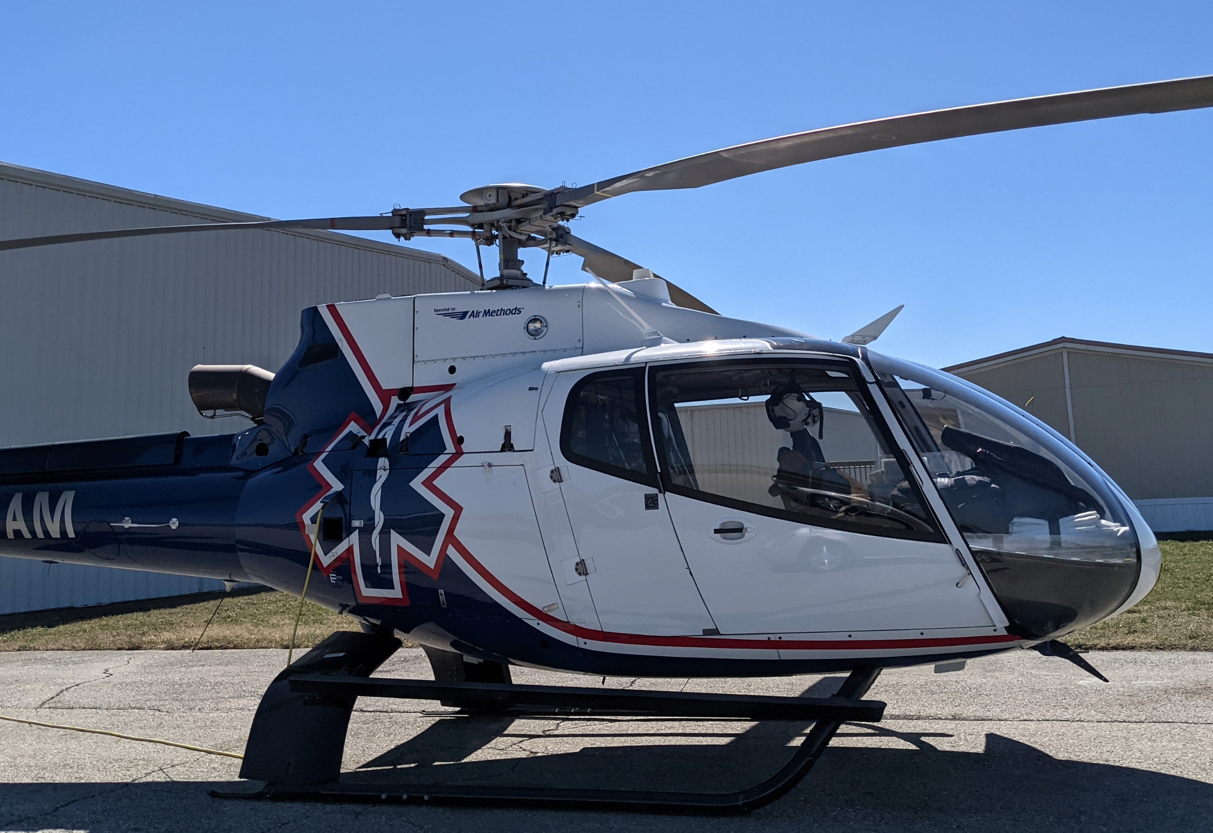

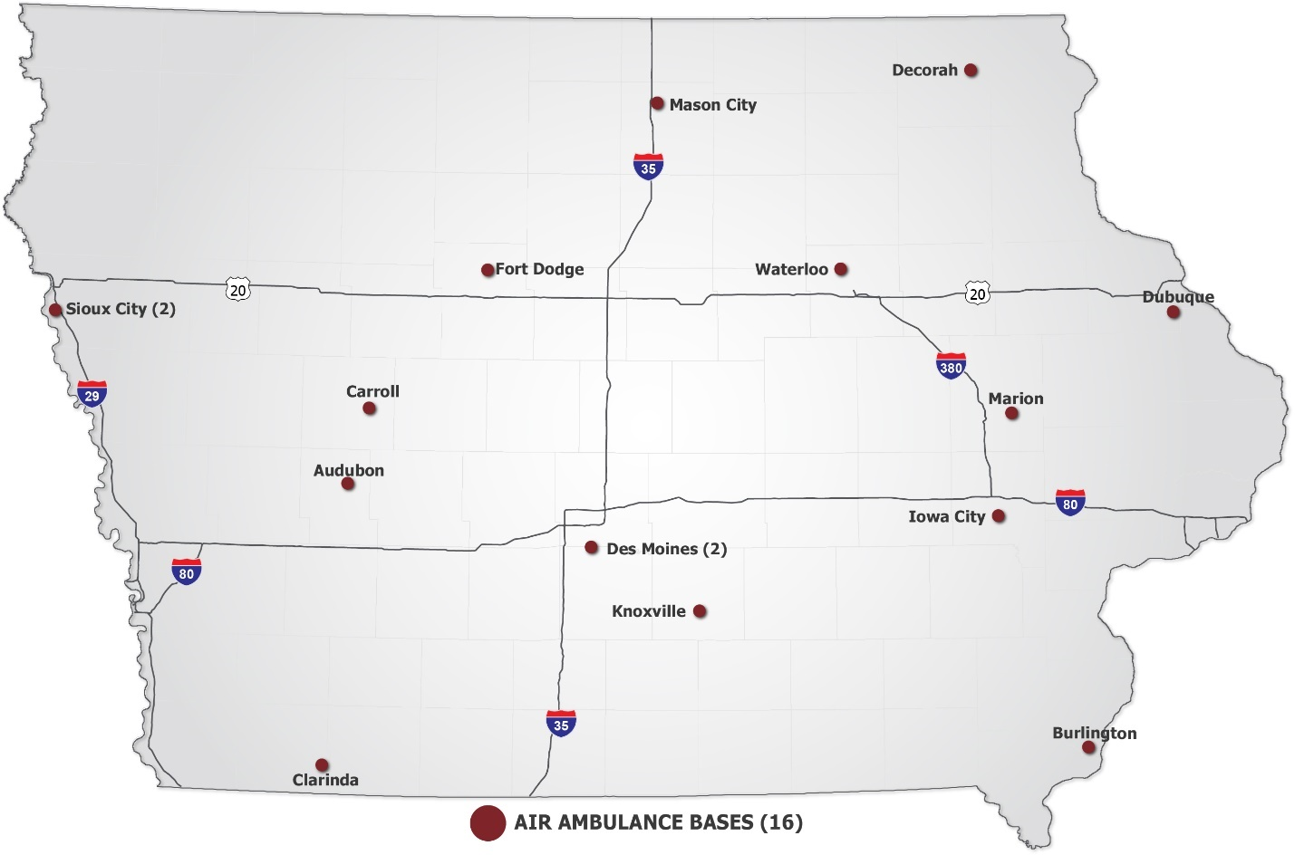
Air Medical
Includes emergency services, ground care, and patient transport
  23
  $449M
Ambulance aircraft
TOTAL IMPACT
Notes:
Air ambulance providers operate 16 bases and 23 aircraft around the state to perform important missions such as emergency medical evacuations and patient transfers between care facilities. The complete scope of air medical services in Iowa includes not only the operation of air ambulance bases and their aircraft, but also the ground-based hospital resources needed to support patients moved by air. Altogether, the impact of air medical activity in Iowa comes in at nearly $450 million in total economic impact.

Slide 11


AERIAL APPLICATORS
Impacts are generated across Iowa
  Fixed wing, helicopter, UAS
  In-state and out-of-state applicators
  $373M
  5M
  105
  400+
YIELD BENEFIT
Acres Sprayed
Airports serving aerial applicators
Registered AG Aircraft
Notes:
Aerial applicators in Iowa use fixed-wing aircraft, helicopters, and drones to apply fungicides, pesticides, fertilizers, and seeds on more than 5 million acres of Iowa land. This activity provides $373 million in additional yield benefit each year. More than 400 agricultural aircraft are registered with the state to provide these services.

Slide 12



PUBLIC SAFETY
Iowa State Patrol relies on aircraft and drones
  Traffic control
  Emergency response
  Search and rescue
  Disaster assessment
  SINCE 1956
AIRCRAFT HAVE BEEN USED TO ENHANCE PUBLIC SAFETY
Notes:
For more than 6 decades, aircraft have been used to enhance public safety. Officers of the Iowa State Patrol’s Air Wing provide traffic control for major events, coordinate emergency response and crash reconstruction services, conduct search and rescue operations, and assess damage following natural disasters. The Air Wing relies on traditional fixed-wing aircraft and is increasingly leveraging drones to enhance their services where possible.

Slide 13


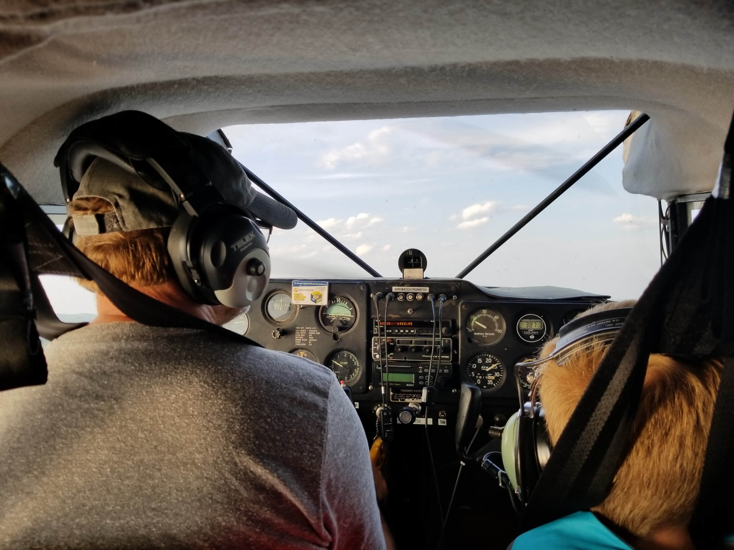

GRASSROOTS AVIATION
Museums, charity flights, and fly-in events are hosted around Iowa
Notes:
Grassroots flying is alive and well in Iowa! Activities from charity flights to museum events and fly-ins offer opportunities for close-up exposure to aviation and leave observers appreciative of the past, and amazed of the possibilities that flying offers. Whether constructing new homebuilt aircraft, or preserving the antiques of the past, jumping out of airplanes to taking off in a balloon, there is something for everyone in the world of aviation.

Slide 14


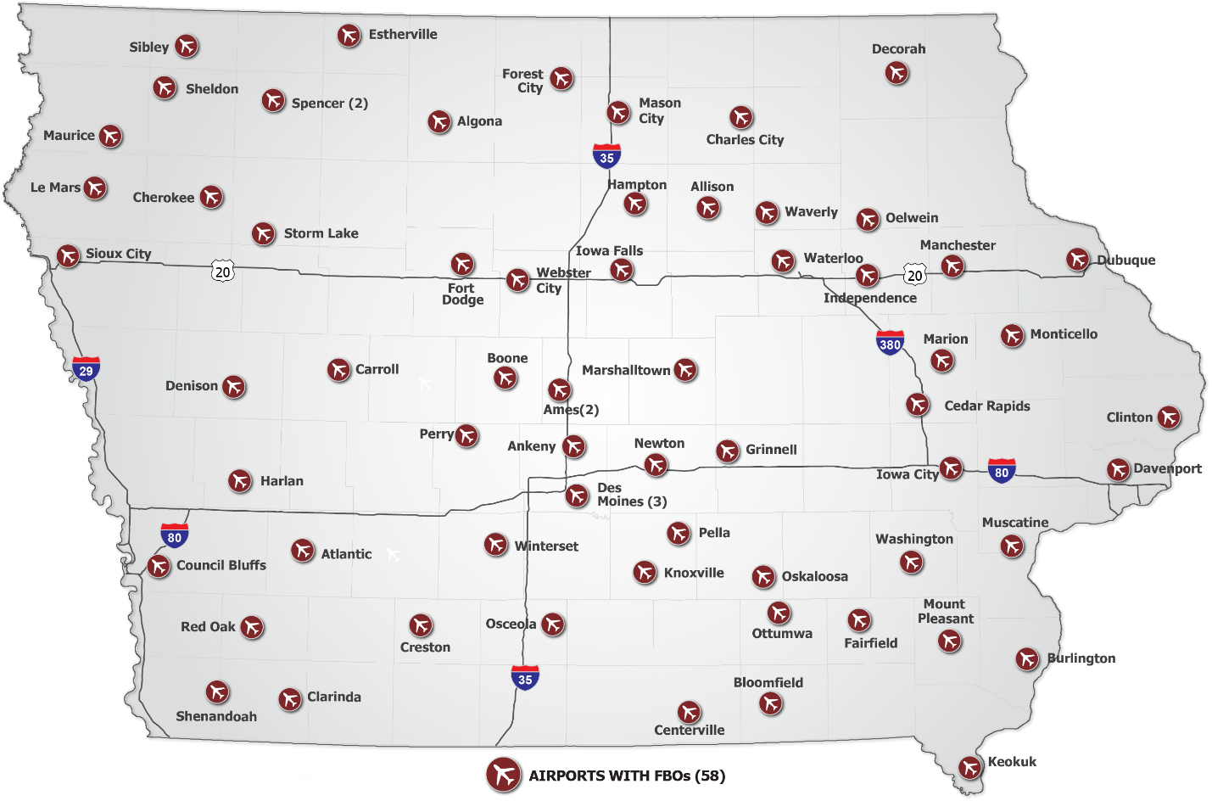
Fixed Base Operators
Focal point of many airports that offers important services for pilots and aircraft.
  62
  58
at
FBOs
Airports
Notes:
A nod of recognition must go to Fixed base operators, or FBOs, who offer facilities and services that make many of the aforementioned activities possible and, in essence, serve as the front door for pilots and passengers for the communities they serve. In Iowa, FBOs at 58 different airports provide refueling, aircraft parking, and pilot and passenger amenities.

Slide 15

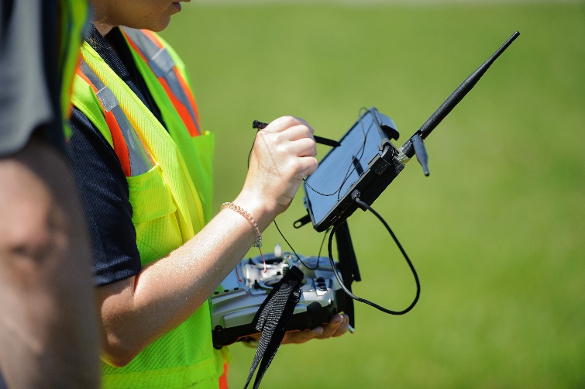
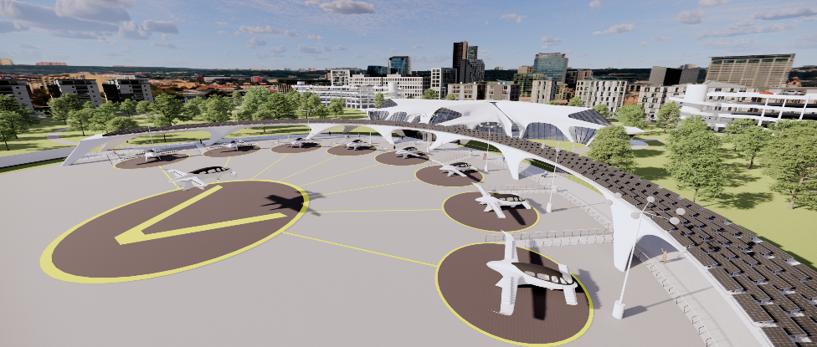
UAS & AAM
  3K+
Cutting-edge technology developed and in use by Iowa businesses
Remote Pilots
Notes:
The continued development of new aviation technologies, such as uncrewed aircraft systems and Advanced Air Mobility, offer a window into the cutting-edge technologies currently in use, or fast approaching that will alter the aviation landscape in Iowa for years to come.
More than 3,000 remote pilots are already licensed to use drones commercially in Iowa. Drones are in use by government agencies, universities, and businesses as a means of completing tasks in a more safe and more efficient manner.
Advanced air mobility technologies are under development around the world and offer the potential to rethink the movement of people and goods through local and regional flights in communities that are currently unserved or inaccessible by traditional aircraft.

Slide 16

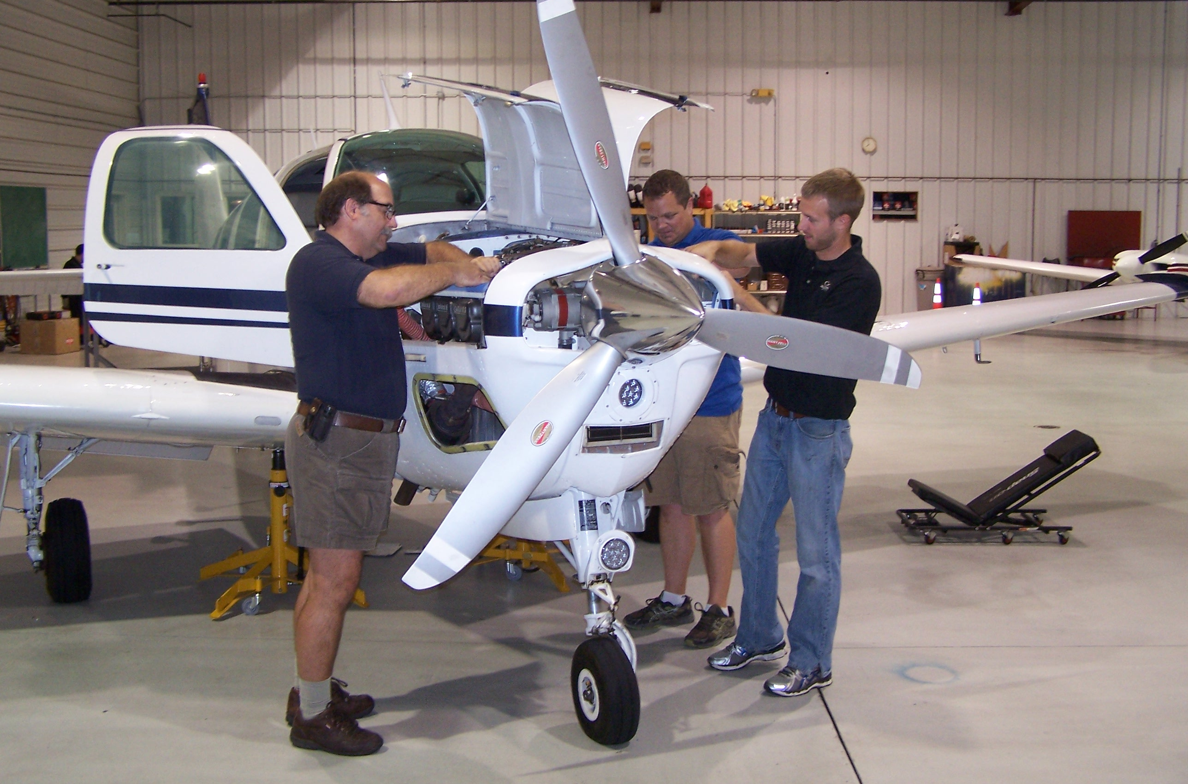
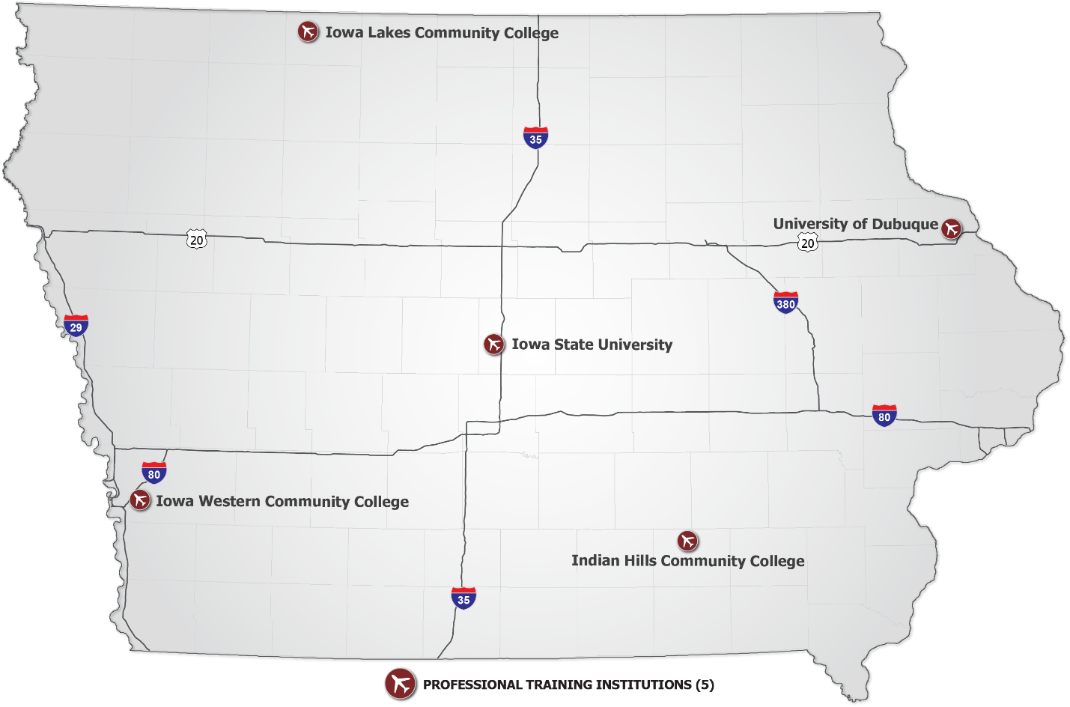
AVIATION EDUCATION
4-year and 2-year programs for future pilots and mechanics
  5
POST-Secondary education programs
Notes:
Iowa is home to five post-secondary education programs that are training the future of the aviation workforce, such as pilots and mechanics. These highly skilled, well-paid positions are in high-demand now and into the foreseeable future. The ability for aviation to continue fueling the economy is dependent on developing a new generation of aviation professionals. These university and community college programs are doing just that.

Slide 17
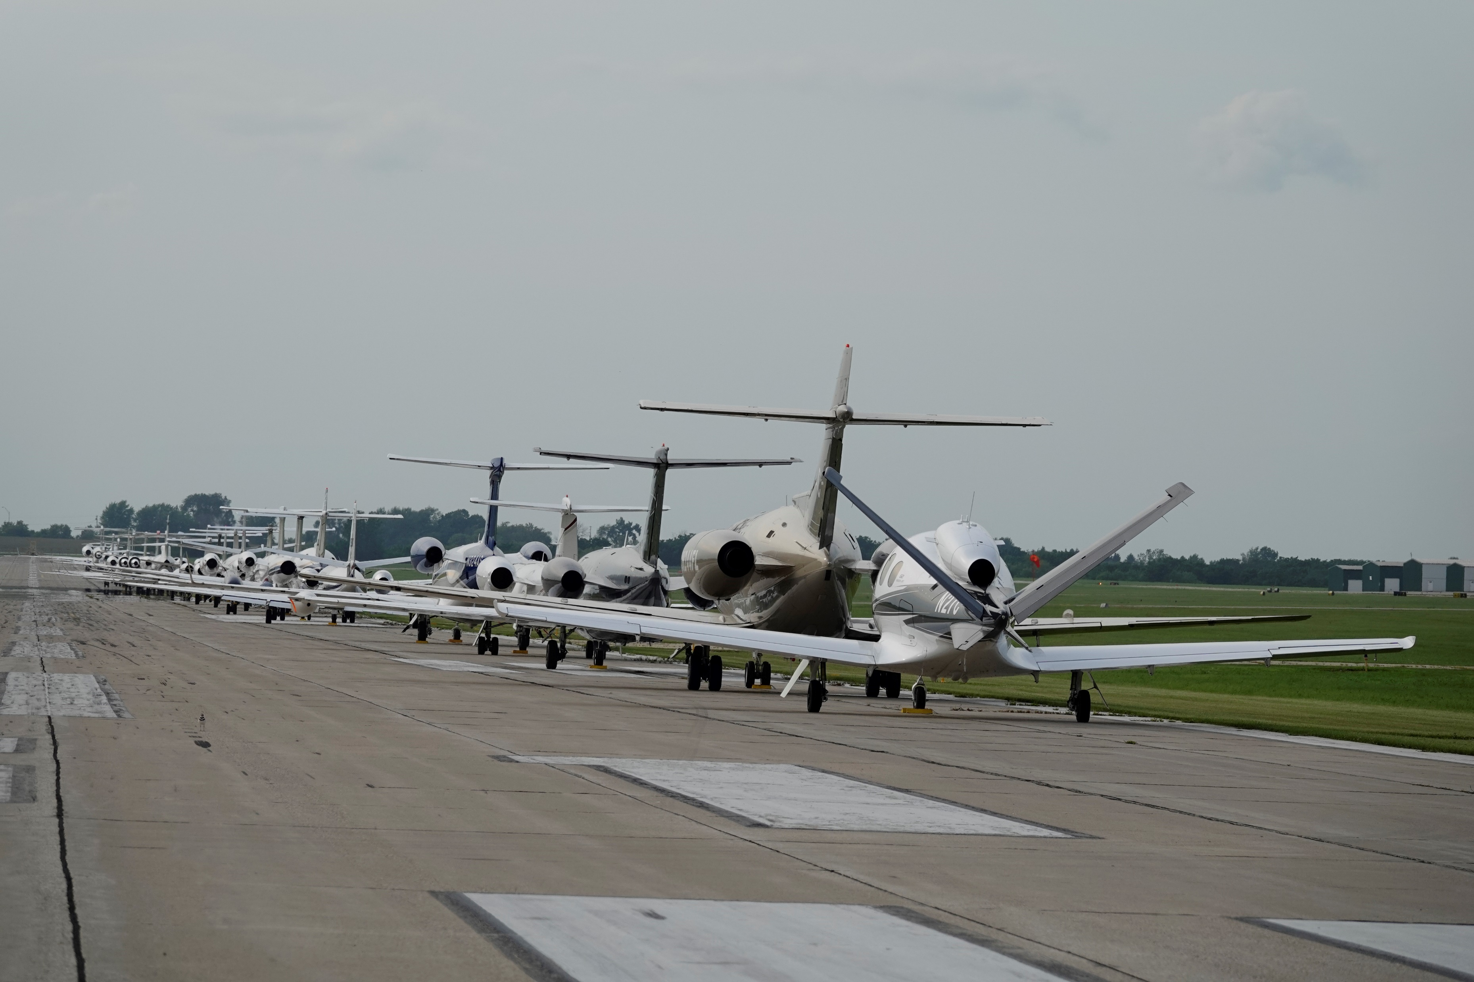
THE ECONOMIC IMPACTS OF AVIATION IN IOWA
Notes:
All of these aviation uses, activities, and services make significant contributions to the quality of life for Iowans and, through this study, also provide measurable economic impacts.

Slide 18

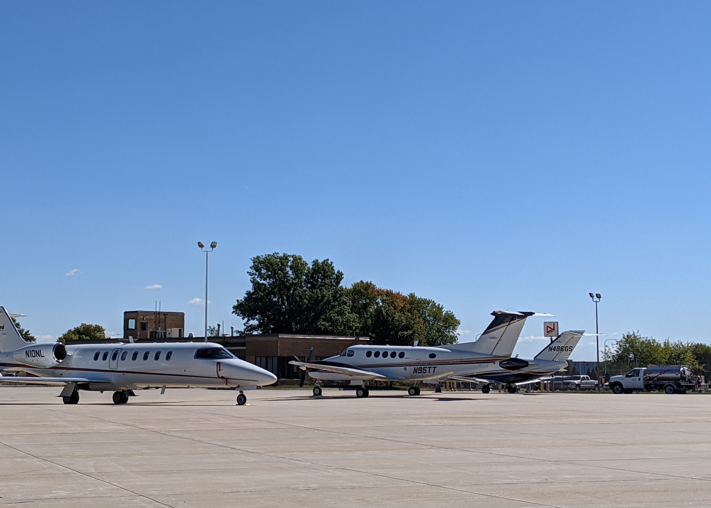
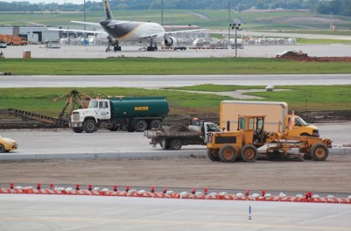
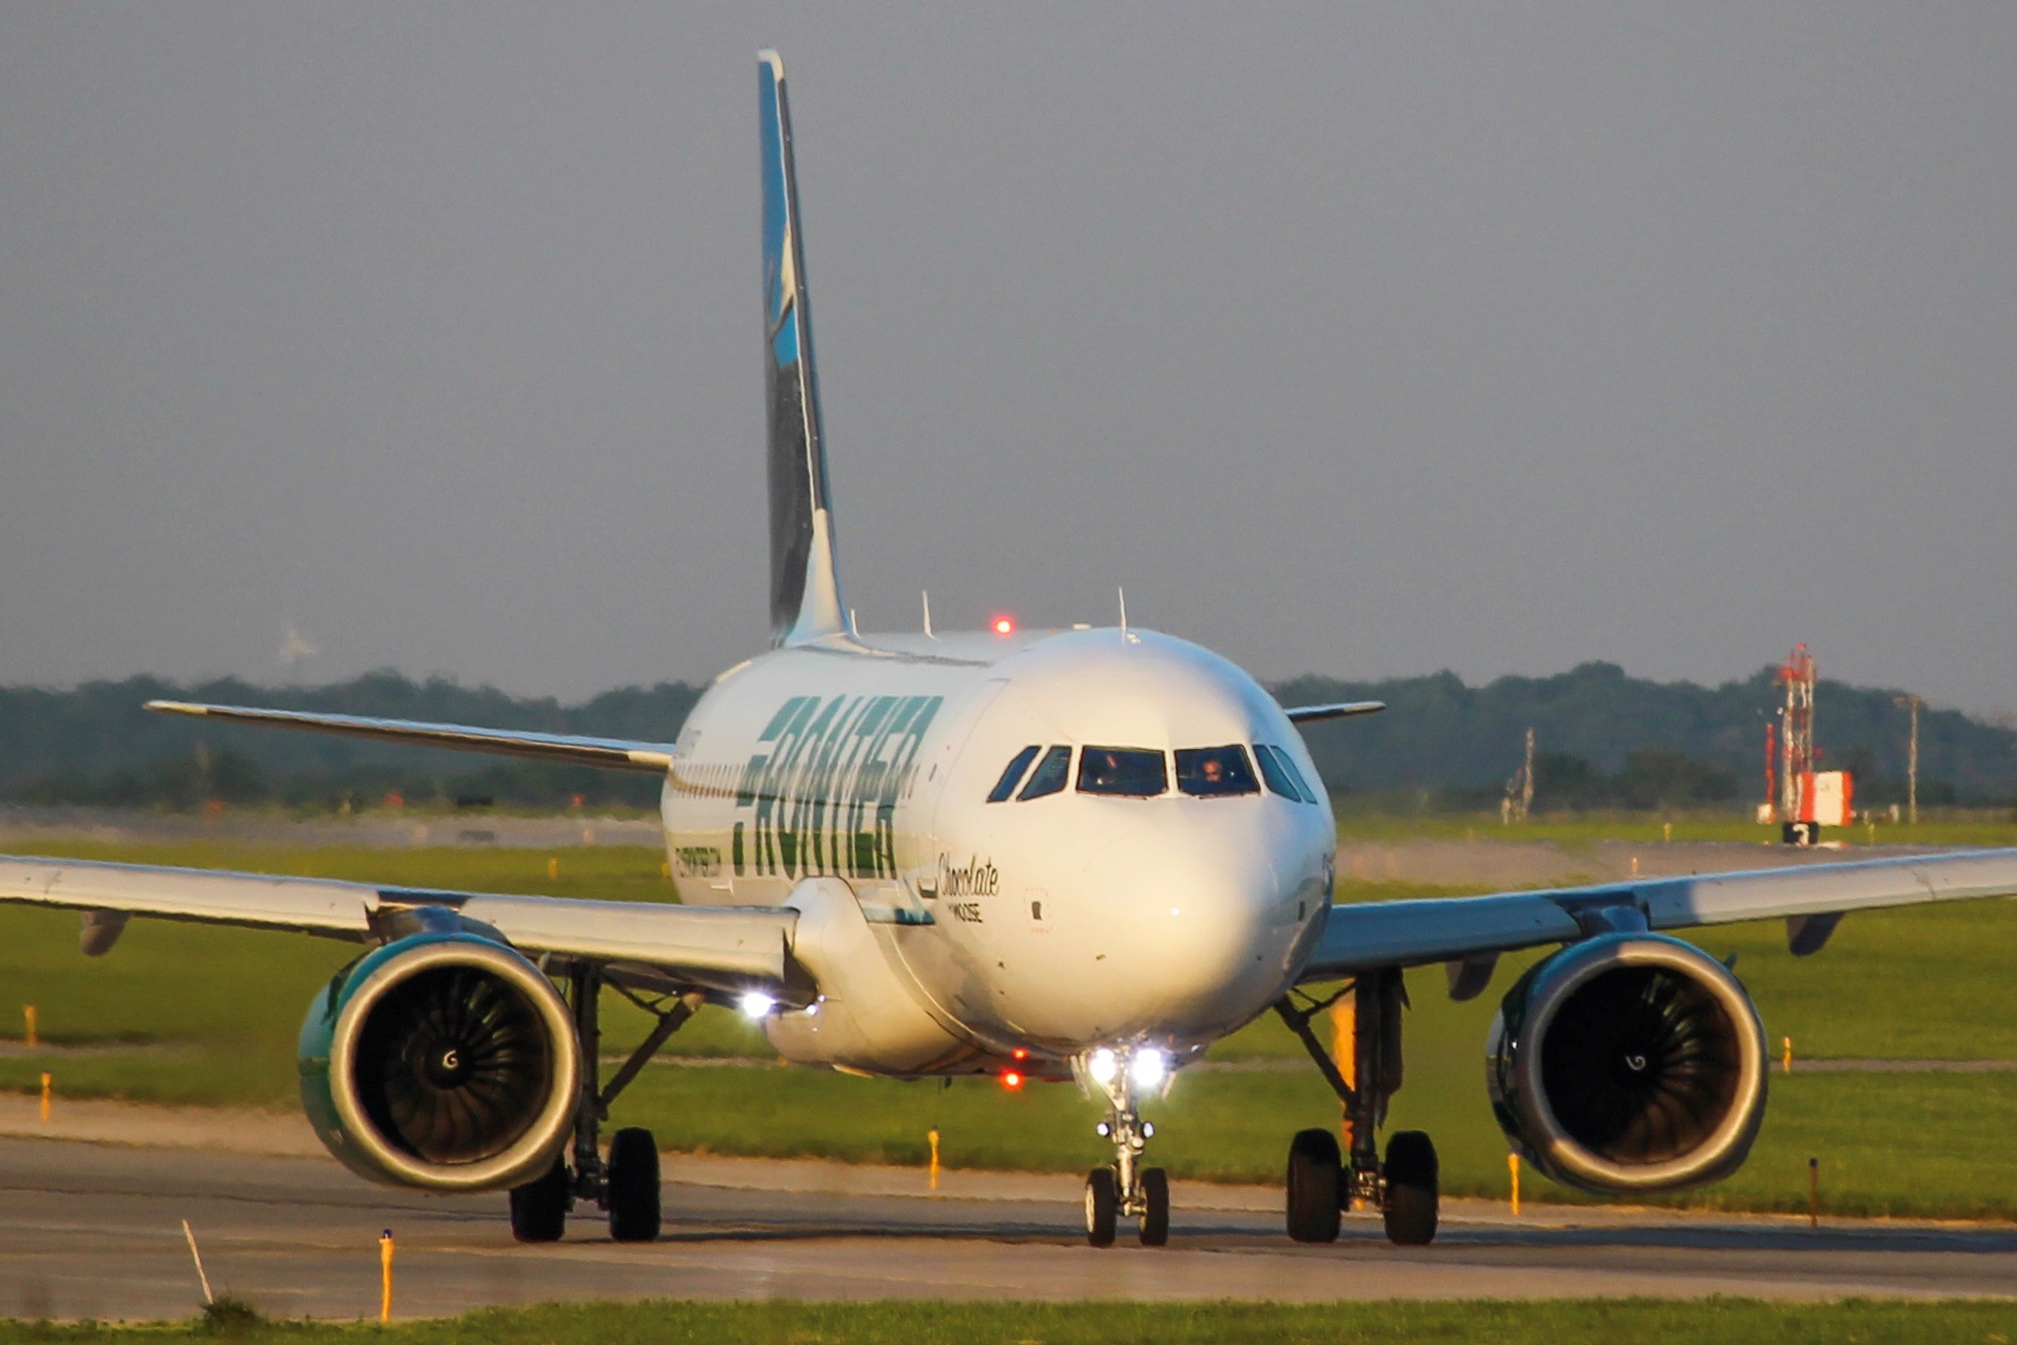
Iowa Airports
On-Airport Activity
Support on-airport activity, construction investment, and visitor spending
  $1.8B
Construction investment
TOTAL ECONOMIC ACTIVITY
  17,000
Total JOB IMPACTS
VISITOR SPENDING
  250+
On-airport BUSINESSES
Notes:
When isolating the benefit of airports alone, Iowa’s airports generate $1.8 billion in total economic activity and support 17,000 total job impacts. These economic impact figures were quantified through an extensive outreach effort to every Iowa airport, every aviation business, and thousands of passenger surveys. Through this effort, more than 250 on-airport businesses were identified, demonstrating the important role these airports play in serving air travel from all types of users.

Slide 19
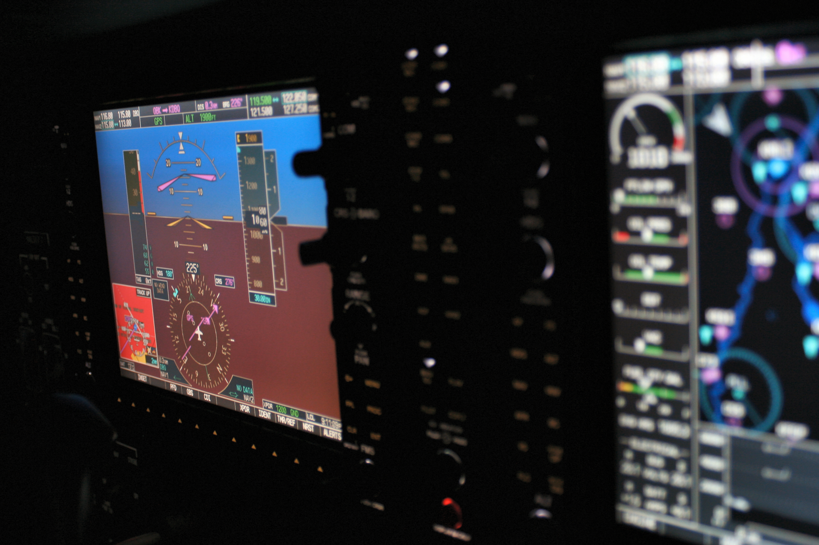

Aerospace
Located in Communities Around the State, Typically Off Airport Property
  $4.6B
TOTAL ECONOMIC ACTIVITY
  24,000
Total JOB IMPACTS
  25+
AEROSPACE BUSINESSES
Notes:
Apart from airport activities, more than 25 aerospace and aviation businesses with a presence in Iowa were identified, along with their contribution to the state economy. Aerospace business contributions add up to $4.6 billion in total economic activity and 24,000 total job impacts. Among the largest are Collins Aerospace in Cedar Rapids, Arconic in Davenport, and Seksui Aerospace in Orange City. These businesses develop products and services that are integral to the nation’s economy and aerospace industry, positioning Iowa as an integral player in aerospace technology.

Slide 20

Aviation-Related
Tax Revenues
Generated from income and purchases tied to the aviation industry in Iowa
  State income tax
  Sales tax
  Use tax
  Aviation fuel taxes
  Aircraft registration fees
  $124M
TOTAL TAX IMPACTS
Notes:
Lastly, the study identified $124 million in tax revenues that are generated from aviation activity in Iowa. This includes state income tax from aviation-related employees and sales taxes from spending on aviation-supported activities. Pilots and aircraft owners contribute to this figure through a use tax on aircraft purchased in Iowa that is applied to each sale, as well as through aircraft registration fees that are paid on an annual basis. Finally, Iowa collects taxes on aircraft fuel sales that go to support aviation programs in Iowa.

Slide 21
  $6.4B
  41,000
  $124M
FOR MORE INFORMATION VISIT: iowadot.gov/aviation
Notes:
To recap, Iowa’s aviation industry generates $6.4 billion in economic impact, 41,000 total job impacts, and $124 million in state and local tax revenues.
The Iowa Aviation Economic Impact Report demonstrates how aviation plays an integral role in Iowa for citizens, businesses, and visitors to the state.
Furthermore, it identifies the significant impact aviation plays in Iowa’s economy. Findings illustrate the importance of maintaining a strong aviation system to keep Iowa’s economy moving forward.
To learn more, visit the Iowa DOT’s aviation website to view the many useful resources produced as part of this study. These include:
A Full Tech report with detailed methodology
An Executive summary
A Fact sheet
Individual airport reports
And more.
Thank you for your time and interest, we hope you find this information as helpful and informative as we do.

